Slide 1


K. RAMAKRISHNAN COLLEGE OF TECHNOLOGY
(AUTONOMOUS), TIRUCHIRAPALLI
AGI1242 – Machine Learning Techniques
AI-BASED FAKE/TAMPERED LICENSE PLATE DETECTION USING MACHINE LEARNING
PRESENTED BY,
MADHUPRITHA P - 2503811724322049
MAHALAKSHMI S - 2503811724322050
MUGESH G - 2503811724321060
MUKESH KRISHNA S - 2503811724321061
Guided By:
Mrs. M. A. Reetha Jeyarani M.E.,
Assistant Professor
AI&DS
2026

Slide 2
OBJECTIVE
Develop an AI-based system that detects vehicle license plates and identifies potentially fake or tampered plates.
Detect license plates from vehicle images or video using computer vision.
Extract plate numbers accurately using Optical Character Recognition (OCR).
Analyse visual and textual characteristics of the plate for inconsistencies.
Identify possible alterations such as irregular spacing, fonts or physical tampering.
Classify each plate as Genuine, Suspicious or Tampered and generate a risk/confidence score.

Slide 3
PROBLEM IDENTIFICATION
Fake or tampered license plates can be used to conceal vehicle identity and support vehicle-related crimes.
Manual verification of large numbers of vehicles is time-consuming and difficult for enforcement teams.
Existing ALPR systems mainly detect and read plates; they do not verify whether a plate is genuine.
Practical challenges include poor lighting, viewing-angle variation, motion blur and low-resolution images.
Further challenges: dirty or damaged plates, deliberately altered characters, and differing plate formats.
An automated tampering-analysis layer can support faster, more consistent preliminary screening.

Slide 4
PROPOSED SYSTEM
Vehicle image or video is captured and preprocessed to improve clarity.
YOLO detects and localises the license plate; the plate region is cropped and enhanced.
OCR extracts the alphanumeric characters from the detected plate.
CNN and XGBoost analyse visual and structured features to detect tampering.
Output: the plate is classified as Genuine, Suspicious or Tampered.
A risk/confidence score and supporting reasons are shown on a dashboard/report.

Slide 5
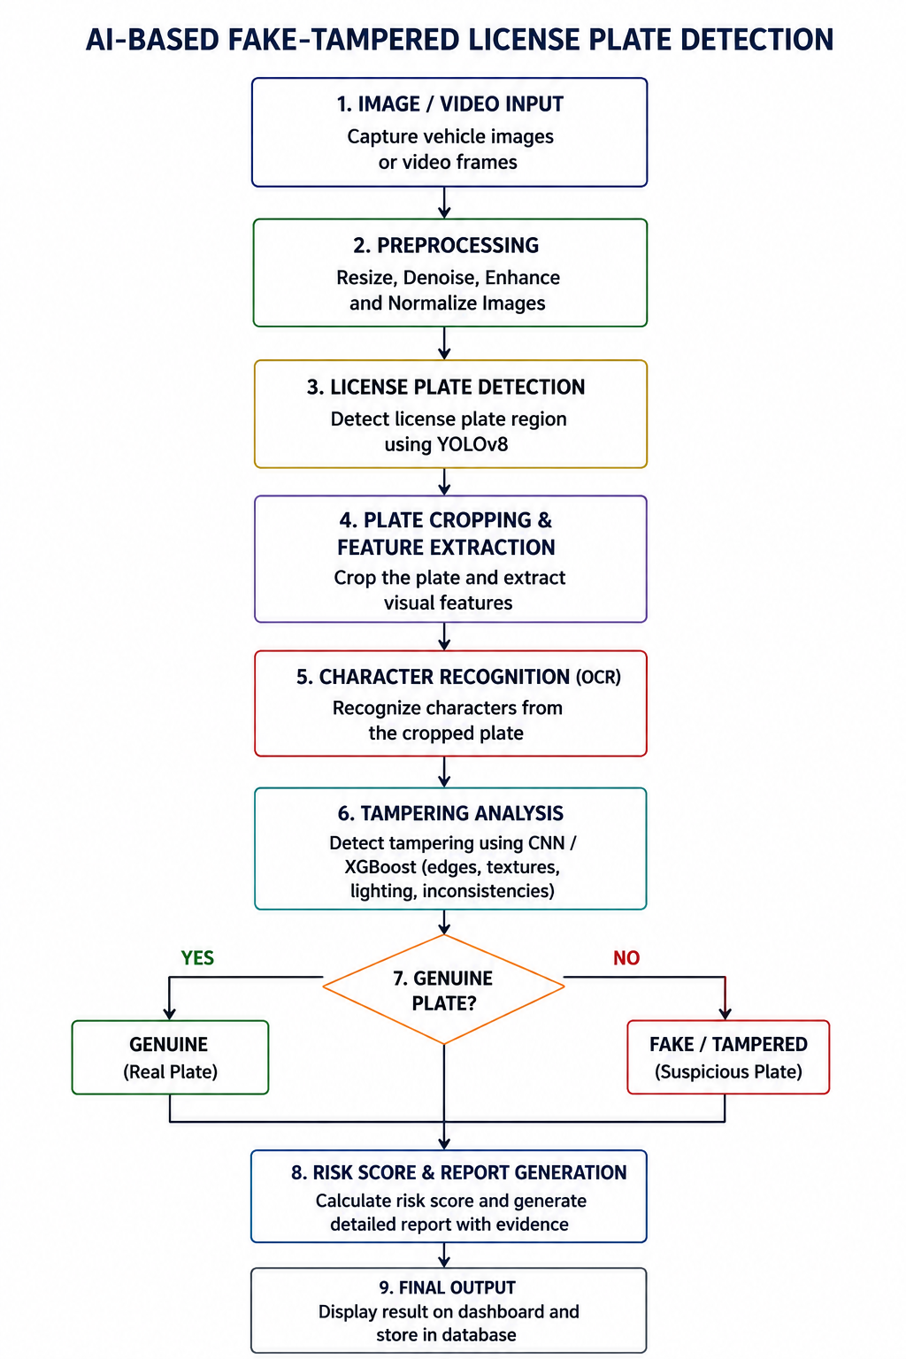
FLOW DIAGRAM

Slide 6
LITERATURE SURVEY – 2023-2026
https://1drv.ms/x/c/6764aba1aa88c2bf/IQDW4pMIBzWoQKfei2iH1nMnAU8uxY3FxnXMDsFeKPsMG8Y

Slide 7
RESEARCH GAP
Most existing ALPR research focuses on detecting and reading the plate number, not on verifying authenticity.
Few studies combine visual tampering cues with structured/database checks in a single pipeline.
Detection accuracy still degrades under poor lighting, extreme angles, motion blur and low resolution.
Most systems output a binary genuine/fake label rather than a graded, explainable risk score.
This project adds a dedicated tampering-analysis and risk-scoring layer on top of standard plate detection and OCR.

Slide 8
RESEARCH METHODOLOGY
1. Data Collection - gather labelled vehicle images/video with genuine and tampered plate examples.
2. Preprocessing - resize, denoise and enhance contrast to improve detection quality.
3. Plate Detection (YOLO) - detects and localises the plate, returning a bounding box for cropping.
4. Character Recognition (OCR) - reads the alphanumeric characters from the cropped, enhanced plate.
5. Feature Extraction (CNN) - analyses visual characteristics such as spacing, font and artifacts for signs of tampering.
6. Classification (XGBoost) - combines visual and structured features to classify the plate.
7. Output - Genuine, Suspicious or Tampered, with a confidence/risk score for the dashboard.

Slide 9
COMPARISON OF ALGORITHMS
Step | Algorithms Compared | Selected | Reason
Plate Detection | YOLO, Faster R-CNN, SSD | YOLO | Fast, real-time, good for small objects like plates
Text Recognition (OCR) | Tesseract, EasyOCR / CRNN | EasyOCR / CRNN | Reads blurry, tilted and varied-font plates better
Feature Extraction | Manual features, CNN | CNN | Learns spacing, font and tampering clues automatically
Classification | SVM, Random Forest, XGBoost | XGBoost | Best on mixed numeric features; high accuracy

Slide 10
IMPLEMENTATION IDEA
Tools: Python, OpenCV, PyTorch and the Ultralytics YOLO library; model training on Google Colab / GPU.
Dataset: Public plate datasets (e.g., CCPD, Indian License Plates) plus synthetic tampered samples made by altering characters, spacing, fonts and adding blur or overlays.
Detection: Fine-tune YOLO on plate bounding boxes; crop and enhance the detected plate region.
Recognition: Run OCR on the crop and validate the text against plate-format rules (regex).
Features: CNN visual features combined with structured features: character spacing, font-height variance, format match and OCR confidence.
Classification: XGBoost outputs Genuine / Suspicious / Tampered; probability becomes the risk score.
Evaluation & UI: Precision, recall, F1, mAP and confusion matrix; Streamlit/Flask dashboard shows result, score and reasons.

Slide 11
MODULES
The system is built using 5 modules:
Module 1 - Image Acquisition & Preprocessing
Module 2 - License Plate Detection
Module 3 - License Plate Recognition
Module 4 - Fake/Tampering Detection
Module 5 - Risk Analysis & Dashboard

Slide 12
MODULE 1 - IMAGE ACQUISITION & PREPROCESSING
Capture vehicle image or video through a camera feed or uploaded file.
Resize images and remove noise for consistent input quality.
Enhance contrast to improve visibility of the plate region.
Prepare the improved image for the plate-detection stage.

Slide 13
MODULE 2 - LICENSE PLATE DETECTION
Use YOLO to detect the license plate within the vehicle image.
Generate a bounding box around the detected plate region.
Crop the plate region for further processing.
Handle multiple plates or partial occlusion where present.

Slide 14
MODULE 3 - LICENSE PLATE RECOGNITION
Apply OCR to the cropped plate to extract characters.
Convert extracted characters into machine-readable text.
Validate the recognised text against expected plate-format rules.
Pass the validated text forward for tampering analysis.

Slide 15
MODULE 4 - FAKE/TAMPERING DETECTION
Extract visual features using a CNN and structured features (spacing, font, format).
Use XGBoost to combine these features for classification.
Detect character-spacing and format inconsistencies that suggest alteration.
Classify the plate as Genuine, Suspicious or Tampered.

Slide 16
MODULE 5 - RISK ANALYSIS & DASHBOARD
Display the classification result and confidence/risk score.
Highlight the specific reasons flagged as suspicious.
Maintain a detection history for review.
Present alerts and reports in a simple, non-technical dashboard.

Slide 17
CONCLUSION
The proposed AI-Based Fake/Tampered License Plate Detection System combines computer vision, deep learning, OCR and machine learning.
Unlike conventional ALPR systems that mainly read plate numbers, this project adds an authenticity/tampering-analysis stage.
The system classifies plates as Genuine, Suspicious or Tampered and provides a risk/confidence score.
It can support traffic monitoring, surveillance and vehicle-security applications as a decision-support tool.
The system does not legally prove a plate is fake from an image alone; results are potentially fake/tampered indicators only.
Future work can extend the model to larger datasets, additional plate formats and multilingual character sets.

Slide 18
THANK YOU

